Slide 1
COPPERBELT UNIVERSITY
CYBER SECURITY

Slide 3
Disclaimer!
The techniques presented in this course are solely for educational purposes only. The learner bears full responsibility for his/her actions arising henceforth.

Slide 4
Intro ... Cont./
Pre-requisites:
Networking, Operating Systems, Security fundamentals

Slide 5
Outline
Introduction
Background and Scope
Threats
Attacks
Security Policies

Slide 6
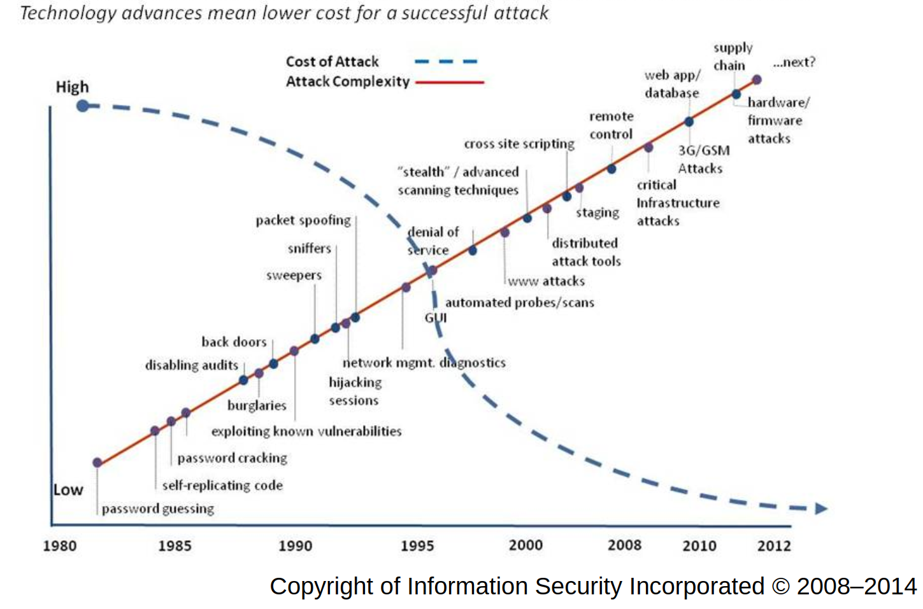
Cyber Attacks Timeline

Slide 7
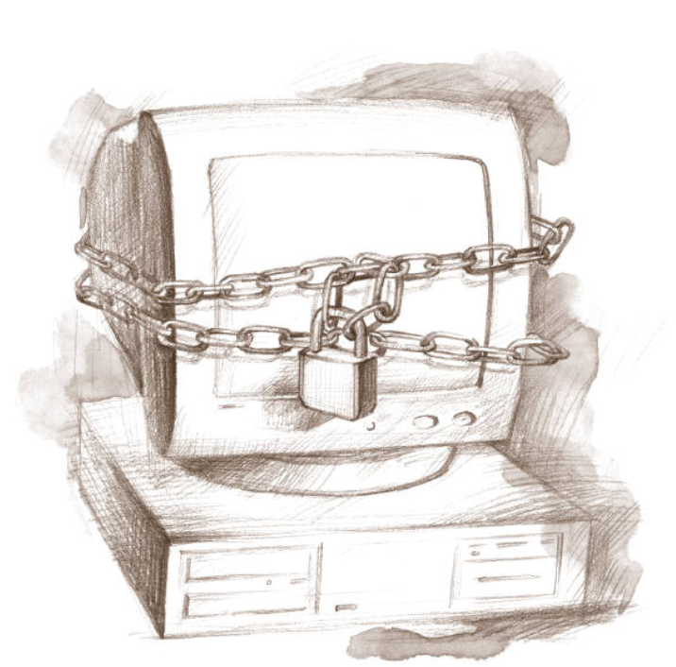
What Should I do?

Slide 8
What is security?
Security is management of access to a resource of a system.
A complete understanding of security should address the following:
  How does the system work?
  How is the system vulnerable and what are the threats?
  How do we prevent harm to the system?
  How do we detect and respond to attacks on the system?
An attack on a system is simply an un-authorised access or an attempt to access a restricted resource

Slide 9
Tenets of Security
Confidentiality
  Secrecy main attribute
Integrity
  Authenticity main attribute
Availability
  Reliability main attribute
The CIA triad.

Slide 10
Threats Attack and Attackers
Threat: a potential violation of security. The violation need not actually occur for there to be a threat.
Attack: an action that causes a threat to occur.
Attackers: entities effectuating an attack.
The three security services confidentiality, integrity, and availability counter threats to the security of a system.

Slide 11
Types of Threats
Errors of users
Natural/man-made/machine disasters
Dishonest insider
Disgruntled insider/ dissatisfied insider
Outsiders

Slide 12
Categories of Threats
Threats can be divided into four broad classes:
  Disclosure - unauthorized access to information;
  Deception (action of deceiving) - acceptance of false data;
  Disruption(disturbance ) - interruption or prevention of correct operation;
  Usurpation( illegall) - unauthorized control of some part of a system.

Slide 13
Attacks
Two basic types of attackers: humans and software
Human actor
  Script kiddie(a relatively unskilled individual who uses scripts or programs, such as a web shell, developed by others to attack computer systems and networks and deface websites, according to the programming and hacking cultures)
  Cyber-criminal
  Hacktivists
  National states
  Criminal actors
  APT
  etc
Malware
  Locker ransomware ( file-encrypting ransomware program)
  Crypto ransomware (encrypt your files and doesn’t allow you to access them until a pay a fee)
  Remote bots
  etc

Slide 14
Attacks
Three broad classes of attacks:
  Reconnaissance attacks-gathering information and learning about vulnerabilities that exist in the system.
  Access attacks- exploit the known vulnerabilities to gain access to the legitmate’s credentials.
  Denial of service (DoS) attacks
ACCESS ATTACKS
Attempts to compromise a legitimate user’s credential set through improper means.
→ Example
(1) Password attacks (2) Trust exploitation
(3) Port redirection (4) Man-in-the-middle (MITM) attacks.

Slide 15
Attacks cont./
  Reconnaissance attacks
Attacker surveys a network and collects data for future attacks.
  Ports open on a server
  Ports open on a firewall
  IP addresses on the host network
  Hostnames associated with the IP addresses
→ Examples
(1) Packet sniffing( is the practice of gathering, collecting, and logging some or all packets that pass through a computer network, regardless of how the packet is addressed) (2) Ping sweeps(establish a range of IP addresses which map to live hosts)
(3) Port scans (4) Information queries( specific request for information from a database)
Utilities/: Wireshark, Ettercap, Nmap, Armitage etc.

Slide 16
Attacks cont./
DENIAL OF SERVICE (DoS) ATTACKS
DoS attack - denying a service that is normally available to a user or organization.
→ Examples
Distributed DoS (DDoS) attack,
TCP SYN attack
Smurf attack.
Ransomware attack

Slide 17
Computer Criminals
Amateurs: regular users, who exploit the vulnerabilities
of the computer system
◻ Motivation: easy access to vulnerable resources
Crackers: attempt to access computing facilities for
which they do not have the authorization
◻ Motivation: enjoy challenge, curiosity
Career criminals: professionals who understand the
computer system and its vulnerabilities
◻ Motivation: personal gain (e.g., financial)

Slide 18
Security Polices
A security policy is a statement of what is, and what is not, allowed in a given system.
Note that security policies don’t precisely define "security.“
A security mechanism is a method, tool, or procedure for enforcing a security policy.
Univ. prohibits copying of assignment in whatever form….
If actor A doesn’t protect her assignment files and B copies them, a breach of security occurs and B violated the policy.

Slide 19
Security Policies cont./
What is secure under one policy may not be secure under a different policy.
A breach of security occurs when a system enters an unauthorized state.
A finite state machine can be used to model a system’s security state.
Example
If Confidentiality, Integrity and Availability …..

Slide 20
Methods of Defense
Prevent: block attack
Deter: make the attack harder
Deflect: make other targets more attractive
Detect: identify misuse
Tolerate: function under attack
Recover: restore to correct state

Slide 21
INFORMATION SECURITY PLANNING

Slide 22
Information Security Planning
Organization Analysis
Risk management
Mitigation approaches and their costs
Security policy
Implementation and testing
Security training and awareness

Slide 23
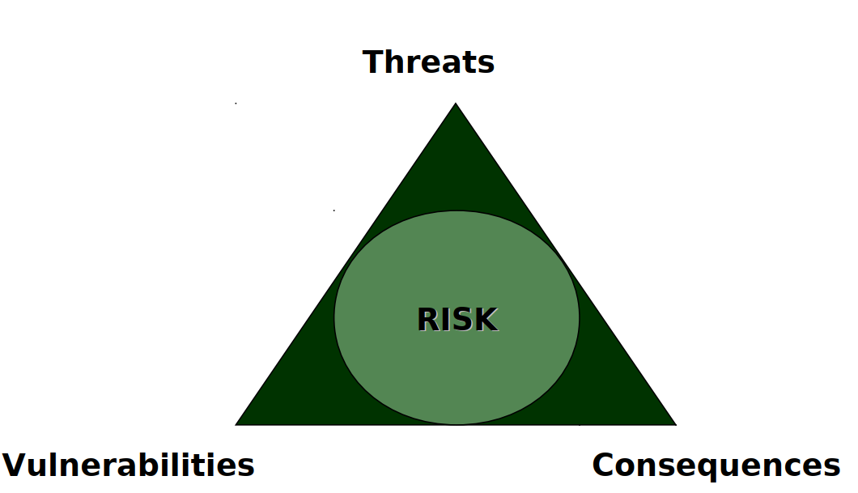
Risk Assessment

Slide 24
Risk Assessment
Business Policy Decision
■ Communication between technical and
administrative employees
■ Internal vs. external resources
■ Legal and regulatory requirements
Developing security capabilities

Slide 25
Real Cost of Cyber Attack
Damage of the target may not reflect the real
amount of damage
Services may rely on the attacked service,
causing a cascading and escalating damage
Need: support for decision makers to
– Evaluate risk and consequences of cyber
attacks
– Support methods to prevent, deter, and
mitigate consequences of attacks

Slide 26
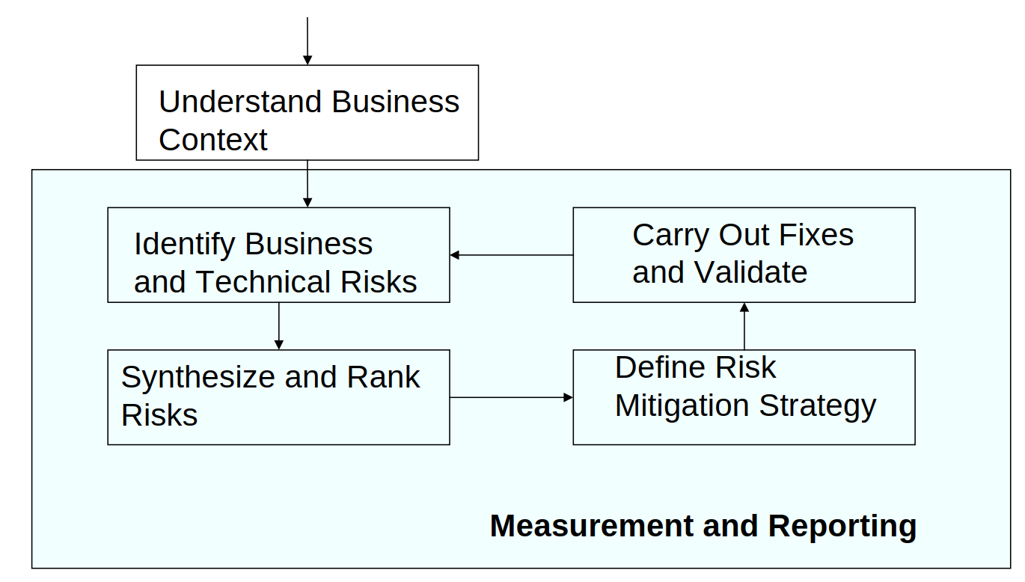
Risk Management Framework

Slide 27
ACCESS CONTROLS

Slide 28
Access Controls
Objectives
  fully understand access control concepts
  methodologies and implementation i.e. centralized and decentralized environments.
  Access control techniques, detective and corrective measures
  Understand potential risks, vulnerabilities, and exposures.

Slide 29
Access Control Overview
Access Controls: The security features that control how users and systems communicate and interact with one another.
Access: The flow of information between subject and object
Subject: An active entity that requests access to an object or the data in an object
Object: A passive entity that contains information
Notes:
All references are from All in One Book (Shon Harris, 2005)
Cornerstone is to control how resources are accessed so that they can be protected from unauthorized modification, use, or disclosure. (p123)
Access controls are security features that are usually considered the first line of defense in asset protection. (217)
Access control is a broad term that covers several different types of mechanisms that enforce access control features on computer systems, networks, and information. (124)
User permissions and rights may be based on their identity, clearance, and/or group memberships. (124)
Access controls give organizations the ability to control, restrict, monitor, and protect resource availability. (124)
Access controls: security features that control how users and systems communicate and interact with other systems and resources. (p123) They protect the systems and resources from unauthorized access and can be a component that participates in determining the level of authorization after an authentication procedure has successfully completed. (123)
Access: The flow of information between subject and object. (p123)
Subject: An active entity that requests access to an object or the data within an object. (p123)
Can be a user, program, or process that accesses an object to accomplish a task. (p123)
When a program accesses a file, the program is the subject and the file is the object.
For a subject to be able to access a resource, it must be identified, authenticated, authorized, and should be held accountable for its actions. (219)
Object: A passive entity that contains information. (p124)
Can be a computer, database, file, computer program, directory, or field in a table in a database, etc. (p124)

Slide 30
Security Principles
The three main security principles also pertain to access control:
  Availability
  Integrity
  Confidentiality
Notes:
All references are from All in One Book (Shon Harris, 2005)
Three main security principles for any type of security control are: (p124)
Availability: Information, systems, and resources need to be available to users in a timely manner to not effect productivity. (p125)
Fault tolerance and recovery mechanisms are put into place to ensure the continuity of the availability of resources. (p125)
Information has various attributes such as accuracy, relevance, timeliness, and privacy (etc.). (p125)
Integrity: When a security mechanism provides integrity, it protects the data/resource from being altered in any unauthorized fashion. (p125)
Confidentiality: The assurance that information is not disclosed to unauthorized individuals, programs, or processes. (p126)
Because of various levels of data, control mechanisms need to dictate who can access data and what the subject can do with it once it is accessed. (p126)
Some security mechanisms that provide confidentiality are encryption, logical and physical access control, transmission protocols, database views, and controlled traffic flow. (218)

Slide 31
Identification, Authentication, and Authorization
Identification, Authentication, and Authorization are distinct functions.
  Identification
  Authentication
  Authorization
Identity Management: A broad term to include the use of different products to identify, authenticate, and authorize users through automated means.

Slide 32
Identification
Identification
  Method of establishing the subject’s (user, program, process) identity.
    Use of user name or other public information.
    Know identification component requirements.
Notes:
All references are from All in One Book (Shon Harris, 2005)
Identification Component Requirements: When issuing identification values to users, the following should be in place: (p129)
Each value should be unique, for user accountability;
A standard naming scheme should be followed;
The value should be nondescriptive of the user’s position or tasks; and
The value should not be shared between users.

Slide 33
Authentication
Authentication
  Method of proving the identity.
    Something a person is, has, or knows.
    Use of biometrics, passwords, passphrase, token, or other private information.
Strong Authentication is important
Notes:
All references are from All in One Book (Shon Harris, 2005)
To be properly authenticated, the subject is usually required to provide a second piece to the credential set (i.e., password, passphrase, key, PIN, anatomical tribute, token). (p126)
The identification and authentication pieces (credential items) are compared to information that has been stored previously for the subject. If the credentials match, then the subject is authenticated. (126)
Entering private information is the authentication step. (128)
Authentication can be accomplished by biometrics, a password, a passphrase, a cognitive password, a one time password, or a token. (219)
Three General Factors used for Authentication: (p129)
Something a person has;
E.g., Key, swipe card, access card, badge, etc.
Downside to this factor is that things can be lost. (129)
This is commonly used to access facilities. (129)
Something a person knows; and
E.g. password, PIN, combination to a lock, etc.
This is usually the least expensive to implement. (129)
Downside is that an unauthorized person could discover this knowledge. (129)
Something a person is.
E.g., based on a physical attribute (Biometrics)
Strong Authentication contains 2 out of 3 of the above methods. (p129)
AKA “two-factor authentication”

Slide 34
Authentication
Biometrics
  Verifies an identity by analyzing a unique person attribute or behavior (e.g., what a person “is”).
Most expensive way to prove identity, also has difficulties with user acceptance.
Many different types of biometric systems, know the most common.
Notes:
All references are from All in One Book (Shon Harris, 2005)
Biometrics: Verifies an individual’s identity by analyzing a unique personal attribute or behavior. Is one of the most effective and accurate means of verifying identification. (p131)
Scans attribute or behavior and compares it to a record that was created in an enrollment process. (p131)
Very sophisticated technology and expensive to implement. (131)
Biometrics is the most expensive method of verifying a person’s identity. (p132)
When reviewing a biometric device for purchase, be sure to look at length of time that it actually takes to authenticate users. (132)
Biometrics faces hurdles to common use, including user acceptance, enrollment timeframe, and throughput. (132)
The enrollment phase requires an action to be performed several times to capture and clear and distinctive reference record. (133)
Many types of different biometric systems. (p133)
Fingerprint: Friction ridges and other detailed characteristics of the print are called minutiae. Distinctiveness of the minutiae is what gives each individual a unique print. (p133)
Palm Scan: Scans and captures the creases, ridges, and grooves throughout the palm that are distinctive to the individual. (133)
Retina Scan: Scans the blood vessel pattern of the retina on the backside of the eyeball. (134)
Iris Scan: Scans uniqueness in the characteristics of in individual’s iris. (134)
Keyboard Dynamics (p134)
This type of authentication is more effective than typing in a password because a password is easily obtainable. It is harder to repeat a person’s typing style.
Each individual has a certain typing style and speed that is translated into unique signals.
Voice Print: Uses subtle distinguishing differences in people’s speech sounds and patterns. Captures a voice print and compares it to the information captured in a reference file. (134)
Facial Scan: Scan looks at bone structures, nose ridges, eye widths, forehead sizes, and chin shapes. (135)

Slide 35
Authentication
Some common biometric systems:
  Fingerprint
  Palm Scan
  Iris Scan
  Keyboard Dynamics
  Voice Print
  Facial Scan
Notes:
All references are from All in One Book (Shon Harris, 2005)
Many types of different biometric systems. (p133)
Fingerprint: Friction ridges and other detailed characteristics of the print are called minutiae. Distinctiveness of the minutiae is what gives each individual a unique print. (p133)
Palm Scan: Scans and captures the creases, ridges, and grooves throughout the palm that are distinctive to the individual. (133)
Hand Geometry: Defined by the shape of a person’s hand (length and width of hands and fingers). (134)
Retina Scan: Scans the blood vessel pattern of the retina on the backside of the eyeball. (134)
Iris Scan: Scans uniqueness in the characteristics of in individual’s iris. (134)
Need to be aware of proper placement of optical unit for scan. (p134)
Signature Dynamics (p134)
Signature dynamics provides more information than a static signature, so there are more variables for measuring identity. (p134)
Keep in mind that a digitized signature is just an electronic copy of someone’s signature and is not a biometric system that captures the speed of signing, the way the person holds the pen, and the pressure the signer exerts to generate the signature.
Keyboard Dynamics (p134)
This type of authentication is more effective than typing in a password because a password is easily obtainable. It is harder to repeat a person’s typing style.
Each individual has a certain typing style and speed that is translated into unique signals.
Voice Print: Uses subtle distinguishing differences in people’s speech sounds and patterns. Captures a voice print and compares it to the information captured in a reference file. (134)
Facial Scan: Scan looks at bone structures, nose ridges, eye widths, forehead sizes, and chin shapes. (135)
Hand Topography: Looks at the different peaks and valleys of the hand along with its overall shape and curvature. (136)
This attribute is not unique enough to authenticate individuals by itself and is commonly used in conjunction with hand geometry.

Slide 36
Authentication
Passwords
  User name + password most common identification, authentication scheme.
  Weak security mechanism, must implement strong password protections
  Implement Clipping Levels
Notes:
All references are from All in One Book (Shon Harris, 2005)
User name coupled with reusable password is the most common form of system identification and authorization mechanisms. (p135)
Passwords are also considered one of the weakest security mechanisms available. (p135)
If passwords are properly generated, updated, and kept secret (read: password management), the can provide effective security. (p136)
If users can choose their own passwords, then the operating system should enforce certain password requirements. (136)
An audit trail can also be used to track password usage and successful and unsuccessful login attempts. (137 * 138))
A password’s lifetime should be short but practical. Forcing a user to change passwords on a more frequent basis provides more assurance that the password will not be guessed; but if too short, causes unnecessary overhead and user errors in remembering password. (Password Aging) (p137 & 138)
Clipping Level: where administrator can set operating parameters that allow a certain number of failed logon attempts to be accepted before a user is locked out for a period of time. (p136)

Slide 37
Authentication
Techniques to attack passwords
  Electronic monitoring
  Access the password file
  Brute Force Attacks
  Dictionary Attacks
  Social Engineering
Know difference between a password checker and a password cracker.
Notes:
All references are from All in One Book (Shon Harris, 2005)
Techniques that attackers can use to get passwords: (p136)
Electronic monitoring: Listening to network traffic to capture information, especially when a user is sending her password to an authentication server. The password can be copied and reused by the attacker later (replay attack). (p136)
Access the password file: Usually done on an authentication server. The password file should be protected with access control mechanisms and encryption. (p136)
Brute Force Attacks: Performed with tools that cycle through many possible character, number and symbol combinations to uncover a password. (p136)
Dictionary Attacks: Files of thousands of words are used to compare to the user’s password until a match is found. (p136)
Social Engineering: An attacker falsely convinces an individual that she has the necessary authorization to access specific resources. (p136)
Password Checker: Tool used by a security professional to test the strength of a password. (p137)
Password Cracker: Same tool as password checker, only tool is used by an attacker. (p137)

Slide 38
Authentication
Passphrase
  Is a sequence of characters that is longer than a password.
  Takes the place of a password.
  Can be more secure than a password because it is more complex.
Notes:
All references are from All in One Book (Shon Harris, 2005)
A passphrase is a sequence of characters that is longer than a password, and in some cases, takes the place of a password during an authentication process. (142)
The user enters this phrase into an application and the application transforms the value into a virtual password, making the passphrase the length and format that is required by the application. (142)
A passphrase is more secure than a password because it is longer, and thus harder to obtain by an attacker. (142)

Slide 39
Authentication
One Time Passwords (aka Dynamic Passwords)
  Used for authentication purposes and are only good once.
  Can be generated in software (soft tokens), or in a piece of hardware
Notes:
All references are from All in One Book (Shon Harris, 2005)
One Time Password (aka Dynamic Password): Used for authentication purposes and is only good once. (139)
This type of system is not vulnerable to electronic eavesdropping, sniffing, or password guessing. (141)
One Time passwords can also be generated in software, in which case a piece of hardware such as a token device is not required. These are referred to as soft tokens and require that the authentication service and application contain the same base secrets, which are used to generate the one time passwords. (141)

Slide 40
Authentication
Smart Cards and Memory Cards
  Memory Cards: Holds but cannot process information.
  Smart Cards: Holds and can process information.
    Contact
    Contactless
      Hybrid
      Combi
Notes:
All references are from All in One Book (Shon Harris, 2005)
A memory card holds information but cannot process information. (142)
Can hold the user’s authentication information, so that the user only needs to type in a user ID or PIN and present the memory card, and if the data that the user entered matches the data on the memory card, the user is successfully authenticated. (142)
Example is a memory card used to enter a building, or an ATM card. (142)
Memory cards can be used with computers, but they require a reader to process the information. (143)
Using a memory card provides a more secure authentication method than using a password because an attacker would need to obtain the card and know the PIN. (143)
A smart card holds information and has the necessary hardware and software to actually process that information. (142)
Has a microprocessor and integrated circuits incorporated into the card itself. (143)
Two general categories of smart card:
Contact: Has a gold seal on the face of the card. When the card is fully inserted into a card reader, electrical fingers wipe against the card in the exact position that the chip contacts are located. This will supply power and the data I/O to the chip for authentication purposes. (143)
Contactless: Has an antenna wire that surrounds the perimeter of the card. When this card comes within an electromagnetic filed of the reader, the antenna within the card generates enough energy to power the internal chip. (143)
Two types of contactless smart cards: hybrid and combi. The hybrid card has two chips, with the capability of utilizing both the contact and contactless formats. A combi card has one microprocessor child that can communicate to contact or contactless readers. (144)

Slide 41
Authentication
Attacks on Smart Cards
  Fault Generation
  Microprobing
  Side Channel Attacks (nonintrusive attacks)
    Differential Power Analysis
    Electromagnetic Analysis
    Timing
    Software attacks
Notes:
All references are from All in One Book (Shon Harris, 2005)
Fault generation: The introduction of computational errors into smart cards with the goal of uncovering encryption keys that are being used and stored on the smart cards. Errors are introduced by manipulating an environmental component of the card (changing input voltage, clock rate, temperature fluctuations).
Microprobing: Intrusive attack. Uses needles to remove the outer protective material on the card’s circuits, by using ultrasonic vibration. Once this is completed, then the data can be accessed and manipulated by directly tapping into the card’s ROM chips. (145)
Side Channel Attacks: Nonintrusive and are used to uncover sensitive information about how a component works without trying to compromise any type of flaw or weakness. (144) Some examples:
Differential Power Analysis: Examining the power emissions that are released during processing (144)
Electromagnetic Analysis: Examining the frequencies that are emitted (145)
Timing: How long a specific process takes to complete. (145)
Software attacks are also considered noninvasive attacks. (145)

Slide 42
Authentication
Hashing & Encryption
  Hash or encrypting a password to ensure that passwords are not sent in clear text (means extra security)
Salts: Random values added to encryption process for additional complexity.
Notes:
All references are from All in One Book (Shon Harris, 2005)
Most systems hash the password with a hashing algorithm, commonly MD4 or MD5, to ensure that passwords are not sent in cleartext. (137)
Salts: Random values that are added to the encryption process to add more complexity. (The more randomness entered into the encryption process, the hard it is to decrypt and uncover the password.) (138)
The use of a salt means that the same password can be encrypted into 4096 different formats, which makes it much more difficult for an attacker to uncover the right format for the target system. (138)-

Slide 43
Authentication
Cryptographic Keys
  Use of private keys or digital signatures to prove identity
Private Key
Digital Signature
  Beware digital signature vs. digitized signature.
Notes:
All references are from All in One Book (Shon Harris, 2005)
Cryptographic keys: Another way to provide one’s identity is to use a private key or generate a digital signature. A private key or digital signature could be used in place of using a password. (141)
Private keys and digital signatures are forms of authentication used in environments that require higher security protection than what is provided by a password. (142)
A private key is a secret value that should be in the possession of one person, and one person only. It should never be disclosed to an outside party. (142)
A digital signature is a technology that uses a private key to encrypt a hash value (message digest). The act of encrypting this hash value with a private key is called digitally signing a message. A digital signature attached to a message proves that the message originated from a specific source and that the message itself was not changed in transit. (142)
Digitized signature: Just an electronic form of a person’s written signature, NOT an authentication mechanism.

Slide 44
Authorization
Authorization
  Determines that the proven identity has some set of characteristics associated with it that gives it the right to access the requested resources.
Notes:
All references are from All in One Book (Shon Harris, 2005)
Is a core component of every operating system and established whether a user is authorized to access a particular resource and what actions he is permitted to perform on the resource. (146)
Granting access rights to subjects should be based on the level of trust a company has in a subject and the subject’s need to know. (146)

Slide 45
Authorization
Access Criteria can be thought of as:
  Roles
  Groups
  Location
  Time
  Transaction Types
Notes:
All references are from All in One Book (Shon Harris, 2005)
Access criteria can be broken up into: (147)
Roles: Is an efficient way to assign rights to a type of user who performs a certain task. This role can be based on job assignment or function. (147)
Groups: Is an effective way to assign access control rights. If several users require the same type of access to information and resources, putting them into a group and then assigning rights and permissions to that group is easier to manage then assigning rights and permissions to every individual. (147)
Location (physical or logical): Can be used to restrict access to resources. Is implemented on several server configurations to restrict unauthorized individuals from being able to get in and reconfigure the server remotely. Usually done through network address restrictions. (147)
Time (temporal isolation): Restrict the times that certain actions or services can be accessed. (147)
Transaction types: Can be used to control what data is accessed during certain types of functions and what commands can be carried out on the data. (147)

Slide 46
Authorization
Authorization concepts to keep in mind:
  Authorization Creep
  Default to Zero
  Need to Know Principle
  Access Control Lists
Notes:
All references are from All in One Book (Shon Harris, 2005)
Authorization Creep: When an employee works for a company over time and moves from one department to another and assigned new access rights and permissions without the old permissions being reviewed and removed. (148)
Default to Zero: All access controls should be based on the concept of starting with zero access and then building on top of that. (148)
Access Control Lists (ACLs): A list of subjects that are authorized to access a particular object. Typically, the types of access are read, write, execute, append, modify, delete, and create. (953)
Need to know principle: Is similar to the lease privilege principle. It is based on the concept that individuals should be given access only to the information that they absolutely require in order to complete their job duties. (148)

Slide 47
Access Control Models
Access Control Models:
Three Main Types
  Discretionary
  Mandatory
  RBAC

Slide 48
Access Control Models
Discretionary Access Control (DAC)
  A system that uses discretionary access control allows the owner of the resource to specify which subjects can access which resources.
  Access control is at the discretion of the owner.
Notes:
All references are from All in One Book (Shon Harris, 2005)
A system that uses discretionary access control (DAC) enables the owner of the resource to specify which subjects can access specific resources. This model is called discretionary because the control of access is based on the discretion of the owner. (162)
Data owners decide who has access to resources and ACLs are used to enforce the security policy. (166)
DAC systems grant or deny access based on the identity of the subject. The identity can be a user identity or group membership. (163)
The most common implementation of DAC is through ACLs, which are dictated and set by the owners and enforced by the operating system. (162)
This does not lend itself to a centrally controlled environment and can make a user’s ability to access information dynamic versus the more static role of mandatory access control. (162)
When you look at the properties of a file or directory and you see the choices that allow you to control which users can have access to this resource and to what degree, you are witnessing an instance of ACLs enforcing a DAC model. (162)
DACs can be applied to both the directory tree structure and the files it contains. (162)

Slide 49
Access Control Models
Mandatory Access Control (MAC)
  Access control is based on a security labeling system. Users have security clearances and resources have security labels that contain data classifications.
  This model is used in environments where information classification and confidentiality is very important (e.g., the military).
Notes:
All references are from All in One Book (Shon Harris, 2005)
In a mandatory access control (MAC) model, users and data owners do not have as much freedom to determine who can access files. (163)
Operating systems enforce the system’s security policy through the use of security labels. (166)
In MAC implementations, the system makes access decisions by comparing the subject’s clearance and need-to-know level to that of the security label. (165)
This type of model is used in environments where information classification and confidentiality is of utmost importance, such as a military installation. (163)
The operating system makes the final decision and can override the user’s wishes. (163)
MAC uses a security label system. Users have clearances and resources have security labels that contain data classifications. MAC compares these two attributes to determine access control capabilities. (218)
Users are given a security clearance and data is classified the same way. Users have access to data classified equal and lesser than their own status. (163)
Security labels are attached to all objects; thus, every file, directory, and device has its own security label with its classification information. (163)
The terms “security labels” and “sensitivity labels” can be used interchangeably. (163)
When a MAC model is being used, every subject and object must have a sensitivity label. (164)
The sensitivity label contains a classification and different categories. (164)
The classification indicates the sensitivity label, and the categories enforce need-to-know rules. (164)
Classifications are hierarchical, categories are not. (164)

Slide 50
Access Control Models
Non-Discretionary (Role Based) Access Control Models
  Role Based Access Control (RBAC) uses a centrally administered set of controls to determine how subjects and objects interact.
  Is the best system for an organization that has high turnover.
Notes:
All references are from All in One Book (Shon Harris, 2005)
A role-based access control (RBAC) model, also called nondiscretionary access control, uses a centrally administered set of controls to determine how subjects and objects interact. (165)
This type of model allows access to resources to be based on the role the user holds within the company. (165)
It is referred to as nondiscretionary because assigning a user to a role is unavoidably imposed. (165)
The RBAC approach simplifies access control administration by allowing permissions to be managed in terms of user job roles. (165)
A role is defined in terms of the operations and tasks that the role will need to carry out. (165)
Introducing roles also introduces the difference between rights being assigned explicitly and implicitly.
If rights and permissions are assigned explicitly, it indicates that they are assigned to a specific individual. (165)
If rights are assigned implicitly, it indicates that they are assigned to a role or group and the user inherits those attributes. (165)
An RBAC is the best system for a company that has high employee turnover. (165)

Slide 51
Access Control Techniques
There are a number of different access controls and technologies available to support the different models.
  Rule Based Access Control
  Constrained User Interfaces
  Access Control Matrix
  Content Dependent Access Control
  Context Dependent Access Control

Slide 52
Access Control Techniques
Rule Based Access Control
  Uses specific rules that indicate what can and cannot happen between a subject and an object.
  Not necessarily identity based.
  Traditionally, rule based access control has been used in MAC systems as an enforcement mechanism.
Notes:
All references are from All in One Book (Shon Harris, 2005)
Rule based access control uses specific rules that indicate what can and cannot happen between a subject and an object. (167)
Before a subject can access an object in a certain circumstance, it must meet a set of predefined rules. (167)
Rule based access control is not necessarily identity based—rules apply to all users across the board, no matter what their identity is. (The DAC model is identity based). (167)
Traditionally, rule based access control has been used in MAC systems as an enforcement mechanism of the complex rules of access that MAC systems provide; today, rule based access is used in other types of systems and applications as well (e.g., routers and firewalls). (167)

Slide 53
Access Control Techniques
Constrained User Interfaces
  Restrict user’s access abilities by not allowing them certain types of access, or the ability to request certain functions or information
Three major types
  Menus and Shells
  Database Views
  Physically Constrained Interfaces
Notes:
All references are from All in One Book (Shon Harris, 2005)
Constrained user interfaces restrict users’ access abilities by not allowing them to request certain functions or information, or to have access to specific system resources. (168)
Limits the user’s environment within the system, thus limiting access to objects. (172)
There are three major types of restricted interfaces: (168)
Menus and shells
The options that a user is given are the commands that they can execute. (168)
A shell is a type of virtual environment within a system; it is the user’s interface to the operating system and works as a command interpreter. (168)
Database views
Are mechanisms used to restrict user access to data that is contained in the database. (168)
Physically constrained interfaces
Can be implemented by providing only certain keys on a keypad or certain touch buttons on a screen. (e.g., atm machine views). (169)

Slide 54
Access Control Techniques
Access Control Matrix
  Is a table of subjects and objects indicating what actions individual subjects can take upon individual objects.
Two types
  Capability Table (bound to a subject)
  Access Control List (bound to an object)
Notes:
All references are from All in One Book (Shon Harris, 2005)
An access control matrix is a table of subjects and objects indicating what actions individual subjects can take upon individual objects. (169)
Matrices are data structures that programmers implement as table lookups that will be used and enforced by the operating system. (169)
Capability table: Specifies the access rights a certain subject possess pertaining to certain objects. (169)
Bounded to a subject and indicates what objects that subject can access. (172)
Is different from an ACL because the subject is bound to the capability table, whereas the object is bound to the ACL. (169)
The capability corresponds to the subject’s row in the access control matrix. (169)
A capability can be in the form of a token, ticket, or key. (169)
A capability component is a data structure that contains a unique object identifier and access rights the subject has to that object. (169)
See Table 4-1, pg. 169
Access Control List (ACL): Lists of subjects that are authorized to access a specific object and they define what level of authorization is granted. Authorization can be specified to an individual or group. (170)
ACLs map values from the access control matrix to the object. (170)
Capability = row in matrix
ACL = column in matrix.

Slide 55
Access Control Techniques
Content Dependent Access Control: Access to an object is determined by the content within the object.
Context Based Access Control: Makes access decision based on the context of a collection of information rather than content within an object.
Notes:
All references are from All in One Book (Shon Harris, 2005)
Content Dependent Access Control (170)
With content based access control, access to objects is determined by the content within the object. (170)
Bases access decisions on the sensitivity of the data, not solely on subject’s identity. (172)
This is often used in databases. E.g., the content of the database fields dictates which users can see specific information within the database tables. (170)
Content dependent filtering is used when corporations employ email filters that look for specific strings, such as “confidential,” “SSN,” “top secret,” etc. (170)
Context based access control differs from content dependent access control in that it makes access decisions based on the context of a collection of information rather than on the sensitivity of the data. (171)
Bases access decisions on the state of the situation, not solely on identity or content sensitivity. (172)
A system that is using context dependent access control “reviews the situation” and then makes a decision. (171)
For example, firewalls make context based decisions when they collect state information on a packet before allowing it into the network. (171)
A stateful firewall understands the necessary steps of communication for specific protocols. (171)
Stateful: Something that understands the necessary steps of a dialog session. Is an example of context dependent access control. (171)

Slide 56
Access Control Administration
First an organization must choose the access control model (DAC, MAC, RBAC).
Then the organization must select and implement different access control technologies.
Access Control Administration comes in two basic forms:
  Centralized
  Decentralized

Slide 57
Access Control Administration
Centralized Access Control Administration:
  One entity is responsible for overseeing access to all corporate resources.
  Provides a consistent and uniform method of controlling access rights.
    Protocols: Agreed upon ways of communication
    Attribute Value Pairs: Defined fields that accept certain values.
Notes:
All references are from All in One Book (Shon Harris, 2005)

Slide 58
Access Control Administration
Types of Centralized Access Control
  Radius
  TACAS
  Diameter
Notes:
All references are from All in One Book (Shon Harris, 2005)
Need to know the properties of each. Detailed examination of each type is beyond the scope of this presentation.
Radius (173)
Remote Authentication Dial In User Service. (173)
Is a client/server authentication protocol and authenticates and authorizes remote users. (173)
Most ISPs today use Radius to authenticate customers before they are allowed to access the Internet. (173)
Radius is an open protocol and can be used in different types of implementations. (173)
Uses UDP as a transport protocol (174)
Only encrypts the user’s password as it is being transmitted from Radius client to the radius server. (174)
Is appropriate protocol when simplistic username/password authentication can take place and users only need an “accept” or “deny” for obtaining access. (176)
Tacacs
Terminal Access Controller Access Control System (173)
Uses TCP as a transport protocol. (174)
Encrypts all user data and does not have the vulnerabilities that are inherent in the radius protocol. (175)
Presents true AAA (Authentication, authorization, and accounting) architecture. (175)
Diameter (176)
A protocol that has been developed to build upon the functionality of radius and overcome many of its limitations. (176)
AAA protocol.
Authentication: Provides PAP, CHAP, EAP, end to end protection of authentication information, replay attack protection. (178)
Authorization: redirects, secure proxies, relays and brokers, state reconciliation, unsolicited disconnect, reauthorization on demand. (178)
Auditing: reporting, ROAMOPS accounting, event monitoring. (178)
Diameter provides the common AAA and security framework that different services can work within. (177)

Slide 59
Access Control Administration
Decentralized Access Control Administration:
  Gives control of access to the people who are closer to the resources
  Has no methods for consistent control, lacks proper consistency.
Notes:
All references are from All in One Book (Shon Harris, 2005)
A decentralized access control administration method gives control of access to the people closer to the resources—the people who may better understand who should and should not have access to certain files, data, and resources. (179)
In this approach it is often the functional manager who assigns access control rights to employees. (179)
Changes happen faster through this type of administration because not just one entity is making changes for the whole organization. (179)
Because no single entity controls access as a whole, different managers and departments can practice security and access controls in different ways. (179)
Has no methods for consistent control, lack of proper consistency. (180)
An example is a peer-to-peer working group. (218)

Slide 60
Access Control Methods
Access controls can be implemented at various layers of an organization, network, and individual systems
Three broad categories:
  Administrative
  Physical
  Technical (aka Logical)
Notes:
All references are from All in One Book (Shon Harris, 2005)

Slide 61
Access Control Methods
Administrative Controls
  Policy and Procedure
  Personnel Controls
    Separation of Duties
    Rotation of Duties
    Mandatory Vacation
  Supervisory Structure
  Security Awareness Training
  Testing
Notes:
All references are from All in One Book (Shon Harris, 2005)
Senior management must decide what role security will play in an organization. (181)
Policy and procedure (181)
It is management’s responsibility to construct a security policy. (181)
A security policy works at the top layer of a hierarchical access control model. (181)
A security policy is a high level plan that states management’s intent pertaining to how security should be practiced within an organization, what actions are acceptable, and what level of risk the company is willing to accept. (181)
Personnel controls (182)
Personnel controls indicate who employees are expected to interact with security mechanisms, and address noncompliance issues pertaining to these expectations. (182)
Separation of Duties (182)
Rotation of Duties (182)
Supervisory structure: Management must construct a supervisory structure in which each employee has a supervisor to report to, and that supervisor is responsible for that employee’s actions. (182)
Security awareness training: As computer security becomes more and more of an issue to companies, they will start to recognize the value of security awareness training. (183)
Testing (183)
All security controls, mechanisms, and procedures need to be tested on a periodic basis to ensure that they properly support the security policy, goals, and objectives set for them. (183)
It is management’s responsibility to make sure that these tests take place. (183)

Slide 62
Access Control Methods
Physical Controls
  Network Segregation
  Perimeter Security
  Computer Controls
  Work Area Separation
  Data Backups
  Cabling
  Control Zone
Notes:
All references are from All in One Book (Shon Harris, 2005)
Physical Controls (181)
Physical controls must support and work with administrative and technical controls to supply the right degree of access control. (183)
Network segregation (183)
Can be carried out through physical and logical means. (183)
Physical: Each area for equipment has the necessary physical controls to ensure that only the permitted individuals have access into and out of those sections. (183)
Perimeter security: Perimeter security mechanisms provide physical access control by providing protection for individuals, facilities, and the components within facilities. (184)
Computer controls: Each computer can have physical controls installed and configured (e.g., locks on the cover, removal of floppy drives, implementation of a protection device to eliminated electrical emissions to thwart attempts to gather information through airwaves). (184)
Work area separation: Some environments might dictate that only particular individuals can access certain areas of the facility. (184)
Data backups: Backing up data is a physical control to ensure that information can still be accessed after an emergency or disruption of the network or system. (184)
Cabling: Protection for the various types of cabling that carry information throughout a network. (184)
Control zone: is a physical control, and is a specific area that surrounds and protects network devices that emit electrical signals. It ensures that confidential information is contained and to hinder intruders from accessing information through the airwaves. (187)

Slide 63
Access Control Methods
Technical (Logical) Controls
  System Access
  Network Architecture
  Network Access
  Encryption and protocols
  Auditing
Notes:
All references are from All in One Book (Shon Harris, 2005)
Are the software tools used to restrict subject’s access to objects. (185)
They are components of operating systems, add-on security packages, applications, network hardware devices, protocols, encryption mechanisms, and access control matrices. (185)
System access: There are many types of technical controls that enable a user to access a system and the resources within that system. (185)
Network architecture: The architecture of a network can be constructed and enforced through several logical controls to provide segregation and protection of the environment. (185)
Logical separation is through IP address ranges and subnets and by controlling the communication flow between the segments. (185)
Network access (187)
Networks can have logical controls that dictate who can and cannot access them and what those individuals can do once they are authenticated. (187)
Switches, routers, firewalls, and bridges all work as technical controls to enforce access restriction into and out of network, and access to the different segments within the network. (187)
Access to different network segments should be granular in nature. (187)
Encryption and protocols: work as technical controls to protect information as it passes throughout a network and resides on computers. (187)
They ensure that the information is received by the correct entity and that it is not modified during transmission. (187)
These controls can preserve the confidentiality and integrity of data and enforce specific paths for communication to take place. (187)
Auditing: Auditing tools are technical controls that track activity within a network on a network device or on a specific computer. (188)

Slide 64
Access Control Types
Each control works at a different level of granularity, but can also perform several functions
Access Control Functionalities(planting carrots return compasations denounce Danny)
  Prevent
  Detect
  Correct
  Deter
  Recover
  Compensate
Notes:
All references are from All in One Book (Shon Harris, 2005)

Slide 65
Access Control Types
Security controls should be built on the concept of preventative security
Preventative Administrative Controls
  Includes policies, hiring practices, security awareness
Preventative Physical Controls
  Includes badges, swipe cards, guards, fences
Preventative Technical Controls
  Includes passwords, encryption, antivirus software
Notes:
All references are from All in One Book (Shon Harris, 2005)
Preventative: Administrative
The following are the soft mechanisms that are put into place to enforce access control and protection for the company as a whole: (190)
Policies and procedures
Effective hiring practices
pre-employment background checks
Controlled termination processes
Data classification and labeling
Security awareness
Preventative: Physical
The following can physically restrict access to a facility, specific work areas, or computer systems: (190)
Badges, swipe cards
Guards, dogs
Fences, locks, mantraps
Locks are usually considered delay mechanisms because they only delay a determined intruder. The goal is to delay access long enough to allow law enforcement or the security guard to respond to the situation. (190)
Preventative: Technical
The following are logical controls that are part of operating systems, third party application add ons, or hardware units: (190)
Passwords, biometrics, smart cards
encryption, protocols, call back systems, database views, constrained user interfaces
Antivirus software, ACLs, firewalls, routers, clipping levels

Slide 66
Accountability
Accountability is tracked by recording user, system, and application activities.
Audit information must be reviewed
  Event Oriented Audit Review
  Real Time and Near Real Time Review
  Audit Reduction Tools
  Variance Detection Tools
  Attack Signature Tools
Notes:
All references are from All in One Book (Shon Harris, 2005)
Review of Audit Information
It does no good to collect it if you do not look at it. (194)
Event Oriented Audit Review: Review of audit logs after a security breach, unexplained system action, or system disruption. (195)
Audit trails can be viewed periodically to watch for unusual behavior of users or systems and help understand the baseline and health of a system. (195)
Real Time and Near Real time: Audit analysis that can use an automated tool to review audit information as it is created. (195)
Audit Reduction Tool: A tool that reduces the amount of information within an audit log. The tool discards mundane task information and records system performance, security, and other functionality information. (195)
Variance Detection Tool: Can monitor computer and resource usage trends and detect variations. (195)
Attack Signature Detection Tool: An application that will have a database of information that has been known to indicate specific attacks. This type of tool parses audit logs in search of certain patterns. If a pattern matches a pattern or signature held within its database, the tool indicates that an attack has taken place or is in progress. (195)

Slide 67
Accountability
Other accountability concepts…
Keystroke Monitoring
  Can review and record keystroke entries by a user during an active session.
  A hacker can also do this
  May have privacy implications for an organization
Scrubbing: Removing specific incriminating data within audit logs
Notes:
All references are from All in One Book (Shon Harris, 2005)
Keystroke Monitoring: A type of auditing that can review and record keystrokes entered by a user during an active session. (195)
A hacker can also use this type of monitoring. (195)
There are privacy issues with this type of monitoring and administrators could be subject to criminal and civil liabilities if it is done without proper notification to the employees and authorization from management. (196)
Protecting Audit Data and Log Information
Scrubbing: Deleting specific incriminating data within audit logs. (196)
Only- certain individuals (administrator and security personnel) should be able to view, modify, and delete audit trail information. (196)
The integrity and confidentiality of audit logs is important because they could be used as evidence in a trial. (196)

Slide 68
Access Control Practices
Know the access control tasks that need to be accomplished regularly to ensure satisfactory security. Best practices include:
  Deny access to anonymous(not identfied by name) accounts
  Enforce strict access criteria
  Suspend inactive accounts
  Replace default passwords
  Enforce password rotation
  Audit and review
  Protect audit logs
Notes:
All references are from All in One Book (Shon Harris, 2005)
Deny access to systems by undefined users or anonymous accounts
Limit and monitor the usage of administrator and other powerful accounts
Suspend or delay access capability after a specific number of unsuccessful logon attempts
Remove obsolete user accounts as soon as the user leaves the company
Suspend inactive accounts after 30 to 60 days
Enforce strict access criteria
Enforce the need to know and least privilege practices
Disable unneeded system features, services, and ports
Replace default password settings on accounts
Limit and monitor global access rules
Ensure that logon IDs are nondescriptive of job function
Remove redundant resource rules from accounts and group memberships
Remove redundant user IDs, accounts, and role based accounts from resource access lists
Enforce password rotation
Enforce password requirements (length, contents, lifetime, distribution, storage, and transmission)
Audit system and user events and actions and review reports periodically
Protect audit logs

Slide 69
Access Control Practices
Unauthorized Disclosure of Information
  Object Reuse
  Data Hiding
Emanation Security
  Tempest
  White Noise
  Control Zone
Notes:
All references are from All in One Book (Shon Harris, 2005)
Object Reuse issues pertain to reassigning to a subject media that previously contained one or more objects. (Means that before someone uses a hard drive, floppy disk or tape, it should be cleared of any residual information that was on it previously.) (198)
Can unintentionally disclose information. (219)
Just removing pointers to files is not always enough protection for proper object reuse. (219)
Degaussing is a safeguard against disclosure of confidential information because it returns media back to its original state. (220)
Data Hiding: When hackers (or others) configure a sector on a hard drive so that it is marked as bad and unusable to an operating system, but the sector is actually fine and may hold malicious data. (198)
Emanation Security
Security to block electrical signals from electronic equipment. (199)
Information can be obtained via electrical signals in airwaves. The ways to combat this type of intrusion are Tempest, white noise, and control zones. (219)
Tempest was a project started by the DoD and then turned into a standard that outlines how to develop countermeasures that control spurious electrical signals that are emitted by electronic equipment. (199)
There is special shielding that is used on equipment to suppress the signals as they are radiated from the devices. (199)
Tempest equipment is implemented to prevent intruders from picking up information through the airwaves with listening devices. (199)
Faraday Cage: An outer metal coating over electronic devices where the metal has the necessary depth to ensure that only a certain amount of radiation is released. (199)
There are allowable limits of emission levels that can radiate and still be considered sage. (199)
Tempest technology is complex, cumbersome, and expensive and only used in highly sensitive areas that really need this high level of protection. (199)
Alternatives to Tempest: white noise or a control zone concept. (199)
White Noise: A uniform spectrum of random electrical signals. It is distributed over the full spectrum so that the bandwidth is constant and an intruder is not able to decipher real information from random noise or random information. (200)
Control Zone: Creates a security perimeter and is constructed to protect against unauthorized access to data or compromise of sensitive information. Using material in walls to contain electrical signals. Prevents intruders from being able to access information that is emitted via electrical signals from network devices. (200)

Slide 70
Access Control Monitoring
Intrusion Detection
  Three Common Components
    Sensors
    Analyzers
    Administrator Interfaces
  Common Types
    Intrusion Detection
    Intrusion Prevention
    Honeypots
    Network Sniffers
Notes:
All references are from All in One Book (Shon Harris, 2005)
Intrusion Detection Systems (IDs) are different from traditional firewall products because they are designed to detect a security breach. (200)
Three common components of all IDS systems: Sensors, analyzers, and administrator interfaces. (201)
Most types of IDSs are capable of several types of responses to a triggered event: (211)
Send a special signal to drop or kill the packet connections (at both source and destination).
Block a user from accessing a resource.
Send an alert of an event trigger to other hosts
Some IDS can reconfigure themselves to perform some predefined action.
IDS Sensors:
Sensor: works as an analysis engine. (209)
Receives raw data from an event generator, and compares it to a signature database, profile, or model, depending upon the type of IDS. (209)
The sensor’s role is to filter received data, discard irrelevant information, and detect suspicious activity. (209)
See example, page 209 (Basic architecture of NIDS)
Spanning port: Where all traffic from all ports can be mirrored to one port. (210)
Sensor placement is a critical part of configuring an effective IDS. (210)
The IDS can be centralized, as firewall products that have IDS functionality integrated within them, or distributed, with multiple sensors throughout the network. (211)
In very high traffic environments, multiple sensors should be in place to ensure that all packets are investigated. (211)

Slide 71
Access Control Monitoring
Two Main Types of Intrusion Detection Systems
  Network Based (NIDS)
  Host Based (HIDS)
HIDS and NIDS can be:
  Signature Based
  Statistical Anomaly Based
    Protocol Anomaly Based
    Traffic Anomaly Based
  Rule Based
Notes:
All references are from All in One Book (Shon Harris, 2005)
Need to know the different features of HIDS and NIDS. Scope is beyond this presentation.
Two main types of IDS:
Network Based IDS, aka NIDS (monitor network communications)
Uses sensors, which are either host computers with the necessary software installed or dedicated appliances, each with its network interface card (NIC) in promiscuous mode. (201)
Monitors network traffic and cannot see the activity going on inside a computer itself. (201)
Host Based IDS, aka HIDS (analyze the activity within a particular computer system)
Can be installed on individual workstations and/or servers and watch for inappropriate or anomalous activity. (201)
Usually used to make sure users do not delete system files, reconfigure important things, or put the system at risk in any other way. (201)
HIDS universe is limited to the computer itself. (201)
HIDS and NIDS can be one of the following types: (201)
Signature Based
Also known as misuse-detection systems. (204)
Signatures: Models of specific attacks and how they are carried out. Each identified attack has a signature, which is used to detect an attack in progress or determine if one has occurred within the network. Any action that is not recognized as an attack is considered acceptable. (202)
Land Attack: A hacker modifies the packet header so that when a receiving system responds to the packet, it is responding to its own address. Vulnerable systems do not have the programming code to know what to do in this situation, so they freeze or reboot. (202)
“In the Wild:” Attacks or viruses that have been discovered in production environments. (202)
“In the zoo:” Attacks or viruses that exist but have not been released. (202)
Pattern matching, similar to antivirus software (208)
Signatures must be continuously updated (208)
Cannot identify new attacks (208)
Statistical Anomaly Based
Also known as profile-based systems. (204)
A profile is built by continually sampling the environment’s activities. (202)
The longer the IDS is in learning mode, the more accurate a profile it will build and the better protection it will provide. (202)
Can detect new attacks (208)
Anything that does not match the profile is seen as an attack, in response to which the IDS sends an alert. (202)
This type of IDS should be able to detect “0 day” attacks and “low and slow” attacks. (203)
Two types:
Protocol Anomaly Based: Unusual format of behavior of protocols (208)
These types of IDS have specific knowledge of each protocol that they will be monitoring, when the IDS is activated, it looks for anomalies that do not match the profiles built for the individual protocols. (208)
Traffic Anomaly Based: Unusual format of traffic patterns. (208)
Detects changes in traffic patters as in DoS attacks or a new service that appears on the network. (205)
The thresholds are tunable to adjust to the sensitivity, to reduce the number of false positives and false negatives. (205)
It can detect unknown attacks. (205)
Rule Based
Commonly associated with the use of an expert system. (205)
An expert system is made up of a knowledge base, inference engine, and rule-based programming. (205)
Use of IF/THEN rule based programming within expert systems (208)
Knowledge is represented as rules, and the data that is to be analyzed is referred to as facts. (205)
The rules are applied to the facts, the data that comes in from a sensor, or a system that is being monitored. (205)
Use of expert system allows for artificial intelligence characteristics (208)
Inference engine. (206)
The more complex the rules, the more demands on software and hardware processing requirements. (208)
Cannot detect new attacks. (208)
Two types:
Stateful matching: Tracking system state changes that indicate an attack is underway. (208)
Every change that an operating system experiences is considered a state transition. (207)
A state transition is when a variable’s value changes, which usually happens continuously within every system. (207)
State: a snapshot of an operating systems values in volatile, semi permanent, and permanent memory locations. (207)
The IDS has rules that outline what state transition sequences should sound an alarm. The activity that takes place between the initial and compromised state is what the state-based IDS looks for, and it sends an alarm if any of the state transition sequences match is pre-defined rules. (207)
Model Based: Models of attack scenarios are built and then captured, data is compared to the models to uncover malicious activities. (208)
The IDS takes in the audit log data and compares it to the different models that have been developed, to see if the data meets any of the models specifications. (208)

Slide 72
Access Control Monitoring
Intrusion Prevention Systems
  The next big thing
  Is a preventative and proactive technology, IDS is a detective technology.
  Two types: Network Based (NIPS) and Host Based (HIPS)
Notes:
All references are from All in One Book (Shon Harris, 2005)

Slide 73
Access Control Monitoring
Honeypots
  An attractive offering that hopes to lure attackers away from critical systems
Network sniffers
  A general term for programs or devices that are able to examine traffic on a LAN segment.
Notes:
All references are from All in One Book (Shon Harris, 2005)
Honeypot: is a computer set up as a sacrificial lamb on the network. (213)
Consider distinction between enticement (offering something attractive) and entrapment (user induced or tricked into committing a crime). (213) Entrapment is illegal. (213)
Network Sniffers
A general term for programs are devices that are able to examine traffic on a LAN segment. (213)
The sniffer has to have a protocol-analysis capability to recognize the different protocol values to properly interpret their meaning. (213)
The sniffer has to have access to a network adapter that works in promiscuous mode and a driver that captures the data. (214)

Slide 74
Threats to Access Control
A few threats to access control
  Insiders
    Countermeasures include good policies and procedures, separation of duties, job rotation
  Dictionary Attacks
    Countermeasures include strong password policies, strong authentication, intrusion detection and prevention
  Brute Force Attacks
    Countermeasures include penetration testing, minimum necessary information provided, monitoring, intrusion detection, clipping levels
  Spoofing at Logon(technques used to steal password)
    Countermeasures include a guaranteed trusted path, security awareness to be aware of phishing scams, SSL connection
Notes:
All references are from All in One Book (Shon Harris, 2005)
The danger of insiders is that they have already been given a wide range of access that a hacker would have to work to obtain, they probably have intimate knowledge of the environment, and generally they are trusted. (214)
Dictionary Attack: This type of program is fed lists (dictionaries) of commonly used words or combinations of characters and then compares these values to capture passwords. (214)
Most operating systems and applications put passwords through hashing algorithms, which result in hash values, also referred to as message digest values. (215)
Countermeasures for dictionary and other password attacks: (215)
Do not allow passwords to be sent in cleartext
Encrypt the passwords with encryption algorithms or hashing functions
Employ one time password tokens
Use hard to guess passwords
Rotate passwords frequently
Employ an IDS to detect suspicious behavior
Use dictionary cracking tools to find weak passwords chosen by users
Use special characters, numbers, and upper and lower case letters within the password
Protect password files.
Brute Force Attack: Generally speaking these are attacks that continually try different inputs to achieve a predefined goal. (i.e., trying every possible combination until the correct one is identified.) (215)
The most effective way to uncover passwords is through a hybrid attack, which combines a dictionary attack and a brute force attack. (215)
Wardialing Attacks: Inserting long lists of phone numbers into a wardialing program in hopes of finding a model that can be exploited to gain unauthorized access. (216)
Countermeasures for a brute force attack: (216)
Perform brute force attacks to find weaknesses and hanging modems
Make sure only necessary phone numbers are made public
Provide stringent access control methods that would make brute force attacks less successful
Monitor and audit for such activity
Employ an IDS to watch for suspicious activity
Set lock)
Lockout thresholds.
Spoofing at Logon: An attacker can use a program that presents to the user a fake logon screen, which often tricks the user into attempting to logon. (216)
This has become a common attack on the Internet in phishing attacks and identity theft attempts. (216)
Countermeasures (217)
Guaranteed trusted path: A communication link between the user and the kernel that cannot be circumvented as described in the scenario of a fake logon screen. (217)
Be skeptical of emails asking you to change/confirm/check accounts
Call the legitimate company regarding the message
Review the address bar to see if the domain name is correct
Looks for SSL connection when submitting financial information or credential data
do not click on embedded links
Do not accept email in HTML format.

Slide 76
Malicious Code

Slide 77
In This lecture
What is Malicious Code?
Viruses
Worms
Trojans
Spyware
Rootkits
Cryptovirology
Mitigation

Slide 78
What is Malicious Code?
Hostile Executable Code
Often referred to as ‘Viruses’, but there are many other forms of malicious code as well
  Worms
  Trojans
  Spyware
  Rootkits
  Others
Collectively known as ‘malware’
Notes:
Malware is an umbrella term to collectively describe all types of hostile executable code. The shared characteristic of all types of malware is that they all involve executable code. This means that they all affect code that is executed by a system, whether this is compiled or interpreted code. The code has to ‘do something’.
While there are a number of documented ‘data driven attacks’ (which as the name suggests, involve an attacker presenting a system with some data that has been crafted to cause some kind of response within that system), this lecture is really going to focus on hostile executable code.

Slide 79
Why we have so much malware
Users are ill-educated, resulting in distribution as Trojans and viruses
  Because computers are fast-changing and still relatively new
Software has vulnerabilities, resulting in distribution of worms and viruses
  Because it is badly written or badly designed
  Because the designers have historically favoured user convenience over security
The PC is an open platform
  Users can install software, in contrast with (old fashioned) mobile phones, mp3 players, set-top boxes, embedded computers, etc.

Slide 80
Threat of monopoly
Another reason for the prevalence of malware is the homogeneity of software
  Most computers run Windows, MS Office, MS Outlook Express, MS Internet Explorer
  This makes the attacker’s job very easy.
In contrast, in the linux world, there is a plethora of rival distributions, office suites, email clients, browsers.
  Makes the attacker’s job much, much harder!

Slide 81
Terminology
Malware is often referred to as viruses (particularly in the more mainstream media)
This terminology is not always correct
There are many types of malware other than viruses
Some recent malware examples do blur the lines between different types
Notes:
Who has not heard the term ‘Computer Virus’? I’m sure most students in this unit have already heard the term. But is this terminology always used correctly?
The term ‘Virus’ is heavily used and often abused, particularly in the more mainstream media. Often mainstream media will use the term virus to describe any number of different types of malware. Sometimes the media will also use terms such as ‘Trojan Virus’ and other combinations. Often the media use these terms incorrectly.
It must be noted however that some types of malware (particularly some of the more recent examples) do tend to blur the lines between some of the more traditional terms. For example some newer worms also exhibit virus-like characteristics.
It is important for students to recognise the different characteristics of different types of malware and can determine for themselves whether or not a piece of malware should be called a virus, trojan, worm or something else.

Slide 82
Types of Malware
Malware
Virus
Worm
Trojan
Rootkit *
Spyware
Others
File Infecting
Email
Remote Access
Bacteria
Boot Sector
Other
Other
Rabbits
Macro
*Note: rootkits could also be considered a subset of Trojans
Notes:
This diagram shows gives an overview of some of the different types of malware and the relationships between them. It should be noted however that this is not a completely exhaustive compilation of type of malware. Also there is some crossover between many of these types of malware. For example, many modern viruses and worms share similar characteristics, as do some trojans and rootkits.

Slide 83
Viruses
This type of malware requires a host
“A virus is a program that can pass on malicious code to other non-malicious programs by modifying them” (Pfleeger, 2003, p 111)
“A program or code that replicates, that is infects another program, boot sector, partition sector or document that supports macros by inserting itself or attaching itself to that medium.” (SARC, 2002)
A computer virus is a program that inserts itself into one or more files and then performs some (possibly null) action.
The first phase, in which the virus inserts itself into a file, is called the insertion phase. The second phase, in which it performs some action, is called the execution phase.

Slide 84
Key Virus Characteristics
Attaches itself to a program or
Can’t survive on their own, i.e. can’t spread without human action.
Usually require some user interaction
  Although this could be very minimal

Slide 85
Types of Viruses
File infecting
Boot sector infectors
Macro
Polymorphic
Stealth

Slide 86
File Infecting Viruses
infects previously non-malicious executable files
  Typically .exe and .com files
Very popular during the 1980s and early-to-mid 1990s
  Not as popular these days, but still around
  People used to share executable files around on disk. This practice is not as common these days
  However, currently people do distribute executable files via email, USB flash disks!

Slide 87
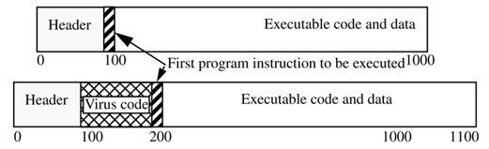
cont./
An executable infector is a virus that infects executable programs.
The virus can prepend itself to the executable (as shown in the figure) or append itself.
The virus inserts itself into the program so that the virus code will be executed before the application code.

Slide 88
Types of File Infectors
Transient
  Virus code only in memory when infected host/file is executed
Memory Resident
  Virus code establishes itself in memory when host is executed
  Attempts to stay in memory from where it can infect other files

Slide 89
Boot Sector Viruses
These establish themselves in the boot sectors of disks.
A boot sector infector is a virus that inserts itself into the boot sector of a disk.
Viral code is executed when computer boots
  Establishes itself in memory
  Tries to infect other disks
Common up until the early-to-mid 1990s
  Not as common any more
  People don’t use bootable disks as much as they used to

Slide 90
Stealth Virus
Stealth viruses are viruses that conceal the infection of files.
These viruses intercept calls to the operating system that access files that are infected.
If the call is to obtain file attributes, the original attributes of the file are returned.
If the call is to read the file, the file is disinfected as its data is returned.
But if the call is to execute the file, the infected file is executed!!!

Slide 91
Worms
“The computer worm is a program that is designed to copy itself from one computer to another, leveraging some network medium: e-mail, TCP/IP, etc.
The worm is more interested in infecting as many machines as possible on the network, and less interested in spreading many copies of itself on a single computer.
The prototypical worm infects a target system only once; after the initial infection, the worm attempts to spread to other machines on the network.”
One common mistake that people make when the topic of a computer virus arises is to refer to a worm or Trojan horse as a virus.

Slide 92
cont./
A worm is similar to a virus by design and is considered to be a sub-class of a virus.
Worms spread from computer to computer, but unlike a virus, it has the capability to travel without any human action.
A worm takes advantage of file or information transport features on your system, which is what allows it to travel unaided.
Unlike a computer virus, it does not need to attach itself to an existing program.

Slide 93
Key Characteristics of Worms
Mainly self contained
Don’t require a separate host
Self Propagation
  Don’t rely on human interaction?

Slide 94
Worm Payloads
Some worms simply replicate for the sake of replicating while others have a more defined payload
Some have attempted to launch Distributed Denial of Service attacks

Slide 95
“Good” worms?
Nachi tried to download and install patches from
Microsoft's website to fix various
vulnerabilities in the host system.
eventually made the systems affected more secure, but generated considerable network traffic Worked without the consent of the computer's owner or user.
Most security experts deprecate worms, whatever their payload.

Slide 96
Trojans
“Trojan Horses are impostors--files that claim to be something desirable but, in fact, are malicious” (SARC, 2002)
A Trojan horse is a program with an overt (documented or known) effect and a covert (undocumented or unexpected) effect.
Appear to do something useful, but in fact have another malicious purpose
Don’t replicate as such
  They don’t usually replicate or infect hosts
  They rely on users being fooled into running them
  Rely on social engineering like techniques

Slide 97
Types of Trojans
Trojan horses are often used in conjunction with other tools to attack systems.
Some are fairly simple
  E.g. imagine a program that acts as a calculator. It adds numbers correctly, but every time you press the 7 key it deletes a random file from the system
Remote Access Trojans (RATs)
  Act as a backdoor
  Allows an attacker control over a system
  Examples – BO2K, Netbus, subseven

Slide 98
Example: NetBus
The NetBus program allows an attacker to control a Windows NT workstation remotely.
The attacker can intercept keystrokes or mouse motions, upload and download files, and act as a system administrator would act.
In order for this program to work, the victim Windows NT system must have a server with which the NetBus program can communicate.
This requires someone on the victim's system to load and execute a small program that runs the server.
This small program was placed in several small game programs as well as in some other "fun" programs, which could be distributed to Web sites where unsuspecting users would be likely to download them.

Slide 99
Example BO2k
Back Orifice 2000 or BO2K is one of the more well known Remote Access Trojans
It is also distributed as a legitimate remote PC control tool
Comes in 2 parts
  Server: Installed on the victim’s machine and actually executes the commands
  Client: Used by the attacker to communicate with and control the server
The next slide shows some screenshots of the configuration of BO2K
This configuration would take place before the attacker tries to get the server onto the victim’s machine

Slide 100
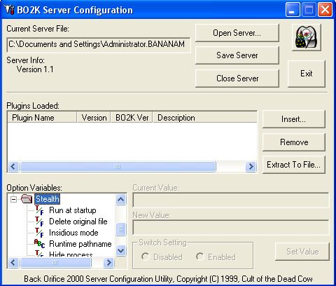
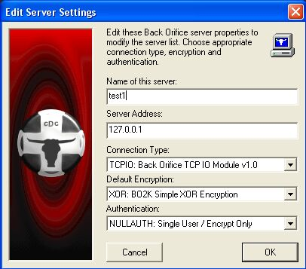
Finalising the configuration of BO2K. Note the Options to hide processes etc. Once this is completed the attacker would try to get the server onto the victim’s system
This shot shows the client about to connect to the server.

Slide 101
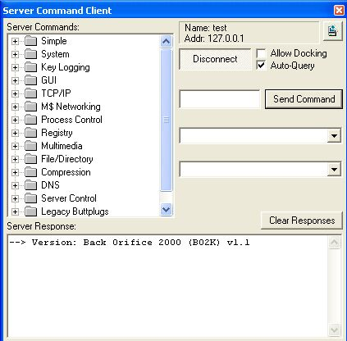
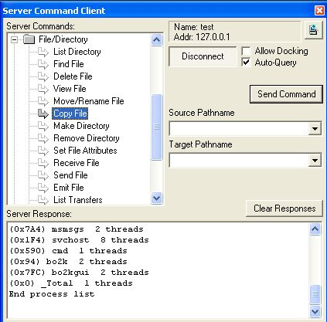
These shots show the BO2K client. The shot on the left shows the categories of the commands that can be executed.
In the shot on the right, the File/Directory has an expanded branch to give the idea of the sorts of file commands that an attacker could execute on the target machine.

Slide 102
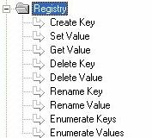
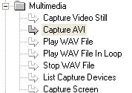


In these screenshots some of the other branches have been expanded to give the an idea of how powerful an attack tool BO2K can be. Can you see the possibilities for an attacker here?
Just a word of warning: Do NOT try this in a public domain and definitely do NOT do this on MU systems.

Slide 103
Trojans cont./
Trojans generally offer an attacker the ability to conduct a highly specific attack
  Viruses and worms tend to have much more generic payloads
  Trojans, particularly RATs can allow an attacker almost complete control of a system
  The attacker could then capture keystrokes, look for a specific file etc

Slide 104
Rootkits
Modified versions of system components are covertly installed on a system
Should rootkits be considered a subset of trojans or another form of malware in their own right?

Slide 105
Rootkits
Often target Linux machines
But Windows versions are certainly a possibility
  Rtkit
Some operate as Loadable Kernel Modules (LKM)
  Code that extends the OS kernel itself
  This type of rootkits is especially dangerous

Slide 106
Rootkit Countermeasures
chkrootkit – a detection tool for Linux systems
  http://www.chkrootkit.org/
System Integrity Verifiers
  A type of Intrusion Detection System (IDS) that uses cryptographic hash functions to test the integrity of files
  Users could also manually use hash functions to check the integrity of files

Slide 107
Spyware
Additional components that get installed along with a legitimate program
These components might gather statistics and send them back to the developers of the spyware components, but there are other types of spyware as well
There are a number of spyware removal tools available
  Spybot Search and Destroy, Ad-aware and others
There have been claims that some programs containing spyware have tried to look for the present of Ad-aware and then uninstall it before installing the spyware
See http://www.spywareguide.com/category_list_full.php

Slide 108
Others
Trapdoors/backdoors
  Could be deliberately written into software at the development stage
  May be deliberately or accidentally left in
  Could allow unauthorised/unauthenticated access
Bacteria/Rabbits
  Programs that replicate and consume system resources, but do not have any other hostile intent

Slide 109
Cryptovirology
studies how to use cryptography to design powerful malicious software.
Traditionally, cryptography is defensive and provides privacy, authentication etc
The use of public key allows the malware to perform trapdoor one-way operations on the victim's computer that only the attacker can undo.

Slide 110
Ransomware virus, cryptovirus, cryptotrojan, lockvirus or cryptoworm
  a type of malware that encrypts the data and demanding a ransom for its restoration.
CryptoLocker in 2013 generated a 2048-bit RSA key pair encrypted files using a whitelist of specific file extensions.
The malware threatened to delete the private key if a payment was not made within 3 days of the infection.

Slide 111
How to mitigate Ransomware?

Slide 112
Malicious Code Countermeasures
Technical
  Anti-malware tools
  Virus Updates
  Specific removal tools
  Advisory sites / virus databases
Non-Technical
  Use caution
  Adhere to policies and procedures
  Stay informed
  Be wary of social engineering attempts

Slide 113
Anti-Malware Software
Usually referred to as anti-virus software
Most modern products deal with more than just viruses
Most use lists of known malware indicators
  Virus definitions
  Vital to keep definitions up to date
  Software is only as good as the last time it was updated
  Most modern products feature scheduled on-line updates
Some use heuristic approaches and look for suspicious behaviour

Slide 114
Summary
Viruses, worms, trojans etc collectively known as ‘malware’
Some newer types of malware blur lines between virus and worms in particular
Malware attacks can be fairly general or highly targeted
Countermeasures can include technical and non-technical controls

Slide 115
CRYPTOGRAPHY

Slide 116
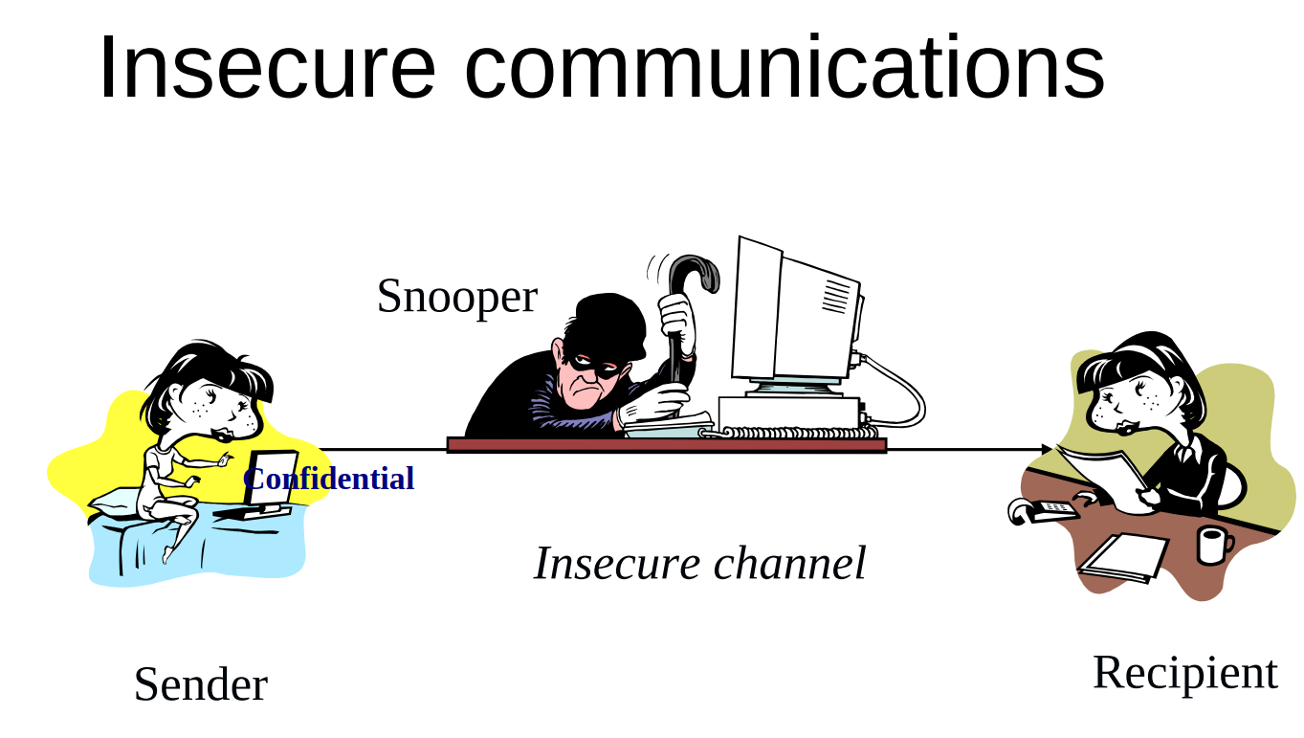
Cryptography

Slide 117
Cryptographic Protocols
Messages should be transmitted to destination
Only the recipient should see it
Only the recipient should get it
Proof of the sender’s identity
Message shouldn’t be corrupted in transit
Message should be sent/received once only

Slide 118
Terminology
Plaintext (cleartext): a message in its original
form
Ciphertext (cyphertext): an encrypted message
Encryption: transformation of a message to hide
its meaning
Cipher: cryptographic algorithm. A mathematical
function used for encryption (encryption
algorithm) and decryption (decryption algorithm)

Slide 119
Terminology
Decryption: recovering meaning from ciphertext
Cryptography: art and science of keeping
messages secure
Cryptanalysis: art and science of breaking
ciphertext
Cryptology: study of both cryptography and
cryptanalysis

Slide 120
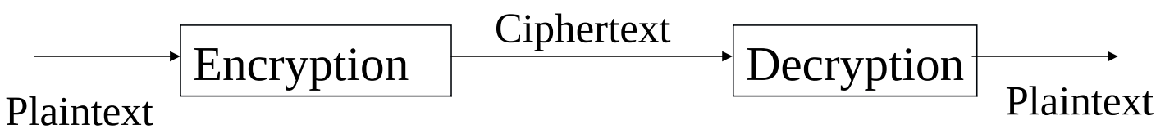
Overview of Encryption and Decryption
Additional requirements:
• Authentication
• Between communicating parties
• Third-party authentication
• Non-repudiation
• Integrity verification
• Key distribution
• Secret key (secure distribution)
• Public key (reliable distribution)

Slide 121
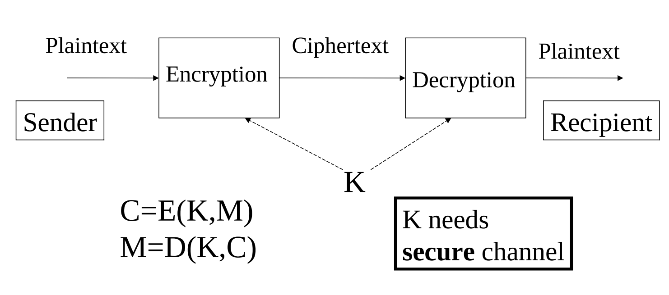
Types of Cryptosystems
1) Conventional (Secret Key) Cryptosystem

Slide 122
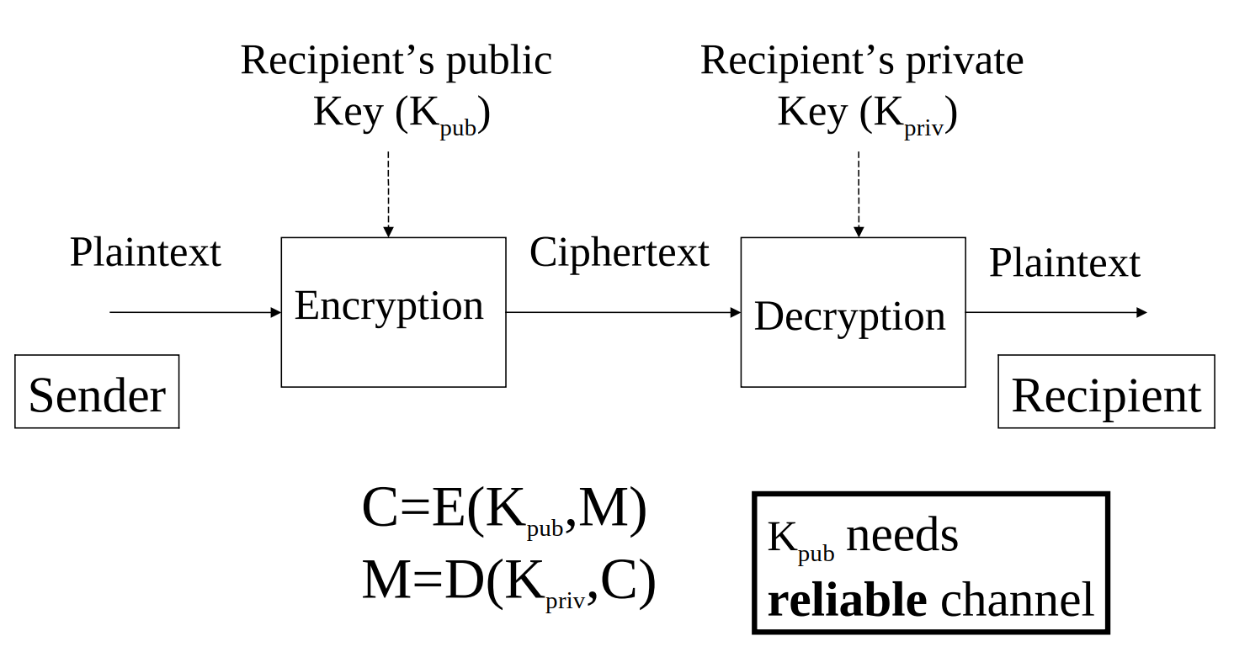
2) Public Key Cryptosystem

Slide 123
Discussion
HOW CAN CRYPTOGRAPHY SUPPORT THESE OBJECTIVES?
Confidentiality
Integrity
Availability
Authenticity
Non-repudiation

Slide 124
Cryptosystem and Cyber Security Objectives
Confidentiality: Hiding message/file content
■ Secret key, public key encryption
Integrity: Detecting modification
■ Hash function
Availability: Not much – hiding existence of data
■ Secret key, public key encryption
Authenticity: Verify origin
■ Public key encryption
Non-repudiation: Verify activity
■ Public key encryption

Slide 125
Crypto Analysis
A form of Attack: the process of studying cryptographic systems to look for weaknesses or leaks of information
Cryptanalyst’s goal:
  Break message
  Break key
  Break algorithm

Slide 126
Breakable versus Practically breakable
Unconditionally secure: impossible to
decrypt. No amount of ciphertext will enable a
cryptanalyst to obtain the plaintext
Computationally secure: an algorithm that is
not breakable in practice based on worst case
scenario
Breakable: all algorithms (except one-time
pad) are theoretically breakable

Slide 127
Vulnerabilities of Cryptosystems
1) Secret Key Cryptosystem
Passive Attacker (Eavesdropper)
Obtain and/or guess key and cryptosystem
use these to decrypt messages
Capture text in transit and try a ciphertextonly attack to obtain plaintext.
Active Attacker
Break communication channel (denial of
service)
Obtain and/or guess key and cryptosystem
and use these to send fake messag

Slide 128
Symmetric Cryptography
Key distribution must be done secretly (difficult when
parties are geographically distant, or don't know each
other)
Need a key for each pair of users
▪ n users need n*(n-1)/2 keys
If the secret key (and cryptosystem) is compromised,
the adversary will be able to decrypt all traffic and
produce fake messages

Slide 129
FIREWALL

Slide 130
Objectives
Keep intruders,malicious code and unwanted traffic or information out
Keep proprietary and sensitive information in

Slide 131
Risks Without Firewall
Nodes:
Are exposed to insecure services
Are exposed to probes and attacks from outsid
Can be defenseless against new attacks
Network security totally relies on host security
and all hosts must communicate to achieve high
level of security – almost impossible

Slide 132
Basic Firewall Features
Routing information about the private network
can't be observed from outside
traceroute and ping -o can't “see” internal hosts
Users wishing to log on to an internal host must
first log onto a firewall machine

Slide 133
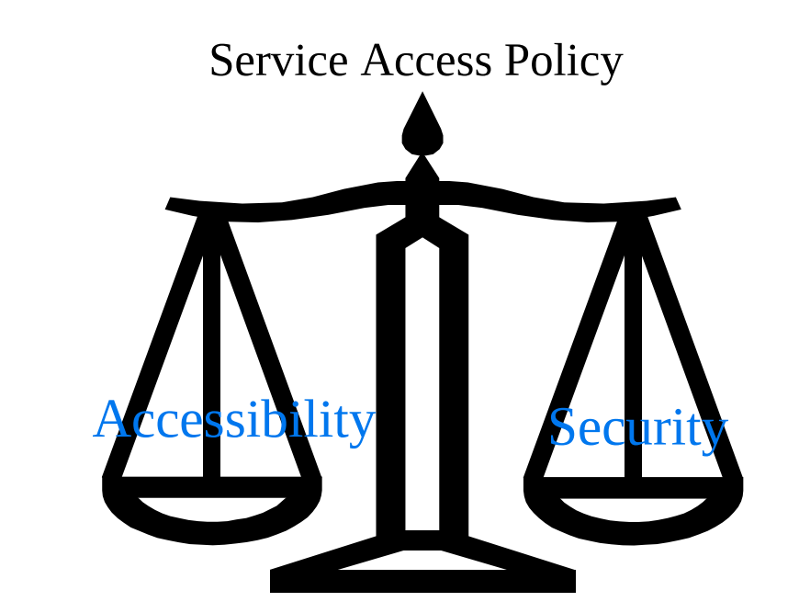
The challenge of balancing Security Firewalls with Accessibility

Slide 134
Firewall Advantages
Protection for vulnerable services
Controlled access to site systems
Concentrated security
Enhanced Privacy
Logging and statistics on network use,
misuse
Policy enforcement

Slide 135
Firewall Disadvantages
Restricted access to desirable services
  May block services that users want
  ■ E.g., telnet, ftp, X windows, NFS, etc.
  ■ Need well-balanced security policy
  ■ Similar problems would occur with host access
  control
Large potential for back doors
  Firewalls DO NOT protect against back
  doors into the site
  ■ e.g., if unrestricted modem access is still
  permitted into a site the attacker could jump
  around the firewall
  ■ Legacy network topology in large networks
No protection from insider attacks
  Generally does not provide protection from
  insider threats
  ■ Sneaker Net - insider may copy data onto
  tape or print it and take it out of the facility

Slide 136
Firewall Disadvantages
No protection against data-driven attacks
  Viruses:
  ■ users downloading virus-infected personal
  computer programs
  ■ Executable Content:
  ■ Java applets
  ■ ActiveX Controls
  ■ JavaScript, VBScript
  ■ End to End Encryption
  ■ Tunneling/Encapsulation
Cannot protect against newly discovered
attacks – policy/situation dependent
Large learning curve

Slide 137
Disadvantages of Firewall
Throughput: potential bottleneck (all
connections must pass through firewall)
Single point of failure: concentrates security in
one spot => compromised firewall is disaster
Complexity - feature bloat
Some services do not work well with firewalls
Lack of standard performance measurements
or technique

Slide 138
Controlled Access
A site could prevent outside access to its
hosts except for special cases (e.g., mail
server).
Do not give access to a host that does not
require access
Some hosts can be reached from outside,
some can not.
Some hosts can reach outside, some can
not

Slide 139
Concentrated Security
Firewall less expensive than securing all hosts
■ All or most modified software and additional
security software on firewall only (no need to
distribute on many hosts)
Other network security (e.g., Kerberos) involves modification at each host system.

